Slide 1
Smart-Hub dashboard Device ece436-Internet of things
By Thiago, Johannes and Anar
Notes:
Title slide or introduction provides title of presentation and member names

Slide 2
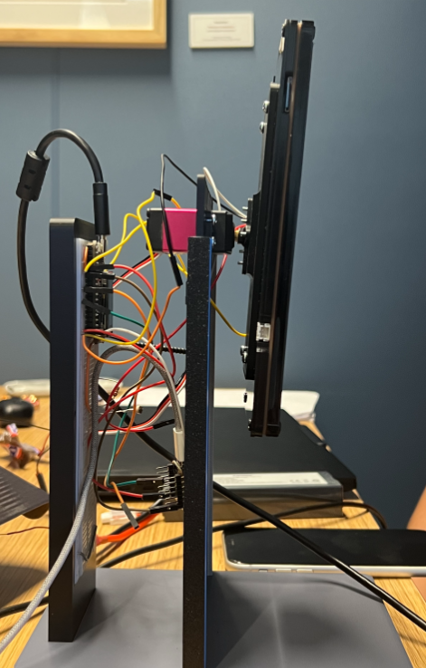
Introduction
Motivation/Problem:
Create IoT based project
User friendly dashboard
Multiple functionalities into single Smart-Hub device
Project overview
Display: 7-inch display with built in ESP32.
Communication Technologies
BLE
LoRa
Wi-Fi
System Architecture including using multiple ESP32 microcontroller.
Camera-based hand gesture interaction
Environmental sensor monitoring
Remote dashboard interaction
Notes:
introduction
motivation/problem statement and project overview
Change the pic

Slide 3
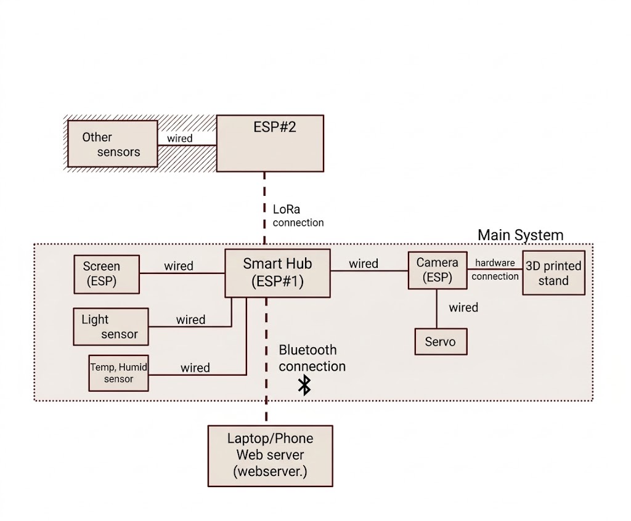
Method and strategy-Our First Design
Design Options:
• Initial modular SmartHub concept
• Multiple ESP32 subsystem approach
• Wireless communication integration
• Expandable architecture design
Notes:
method and strategy
evaluation of design options
design decisions and overview

Slide 4
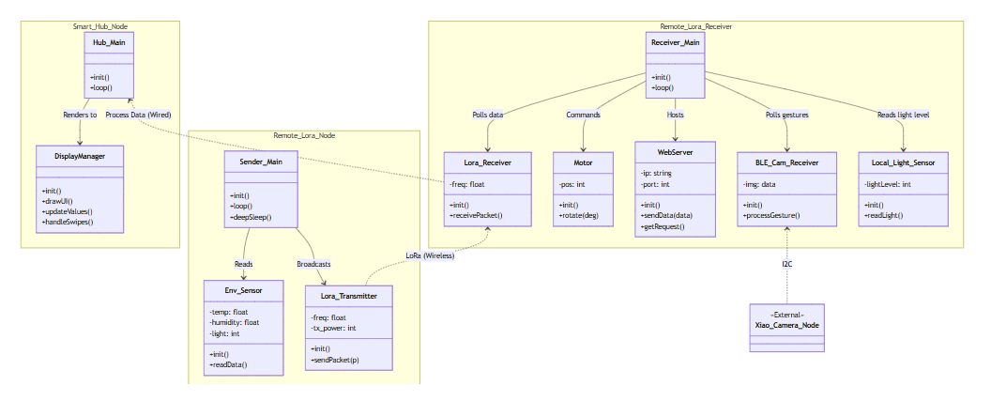
Method and strategy-Architecture

Slide 5
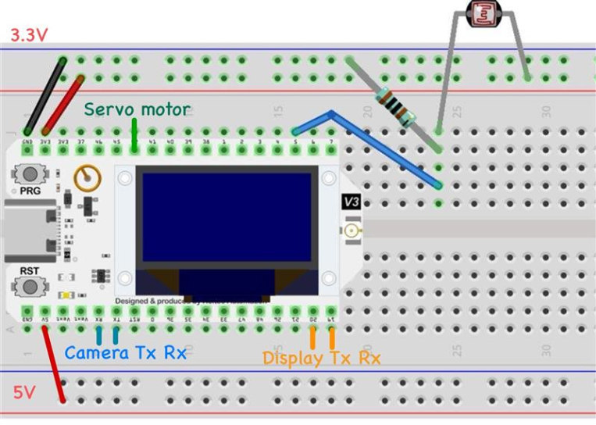
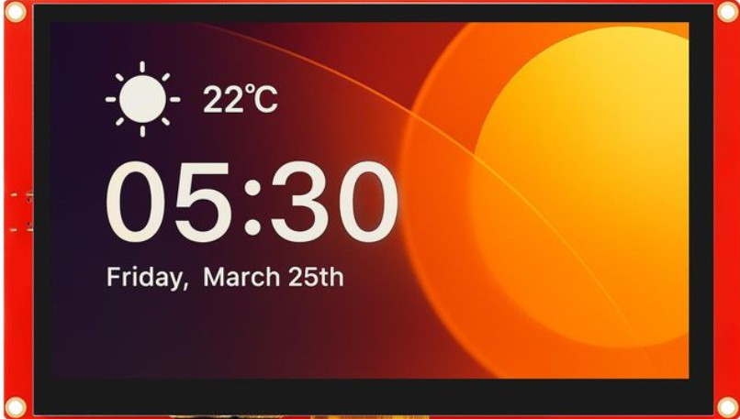
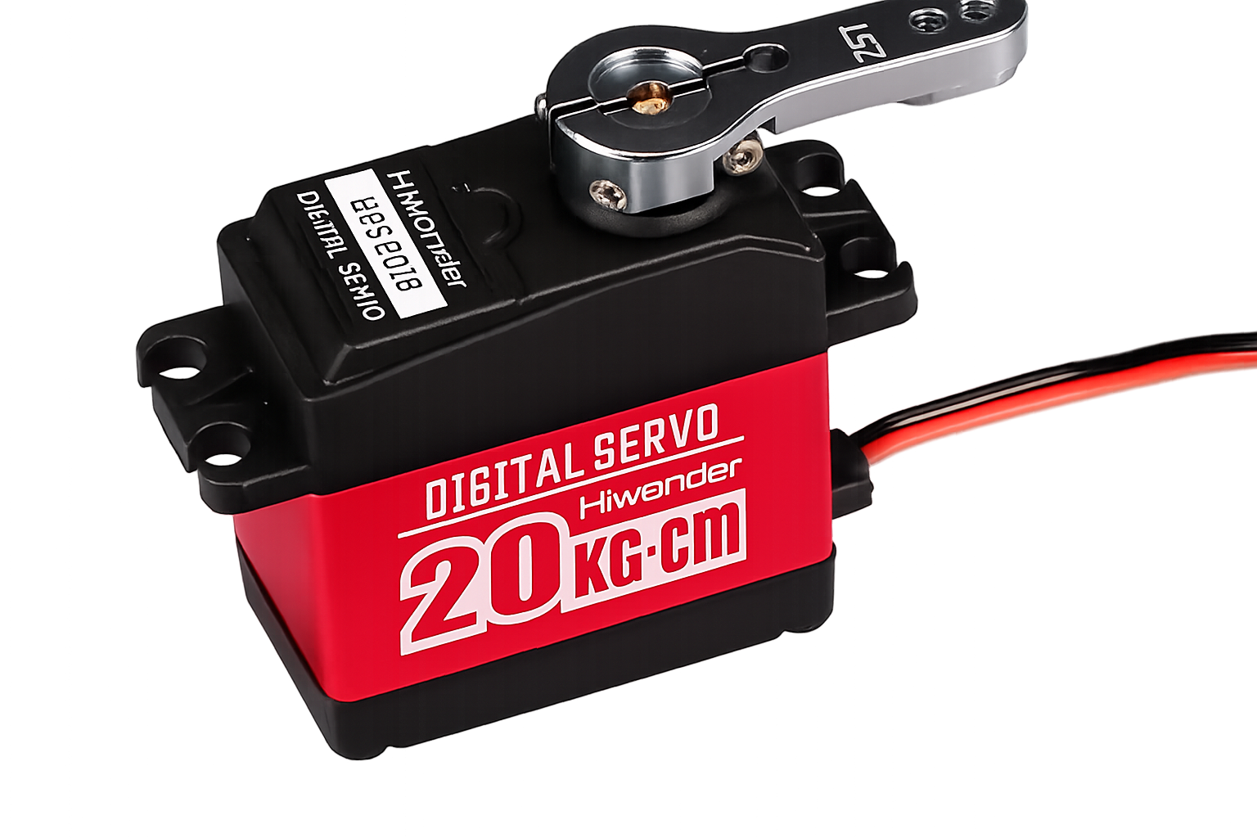
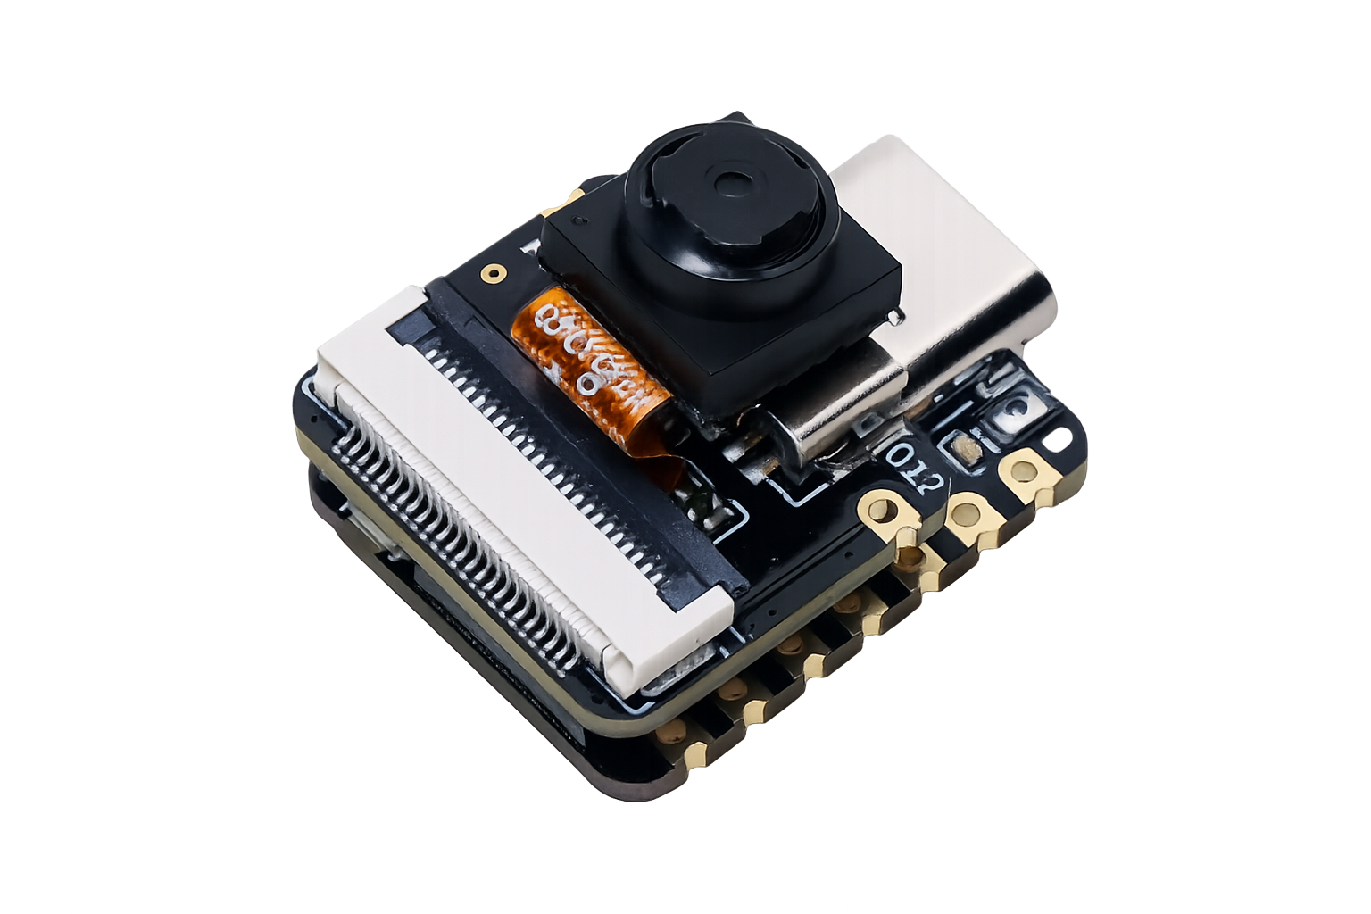
Method and strategy-Architecture The main hub

Slide 6
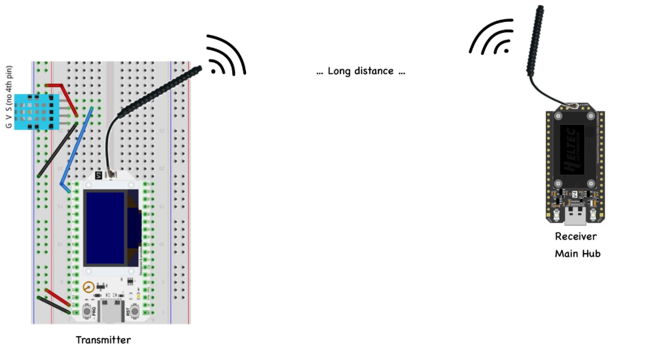
Method and strategy-Communication Technologies
Lora Communication
Operates at 915 MHz using SX1262 LoRa transceivers
Provides long-distance wireless communication
One ESP32 acts as the LoRa transmitter node
One ESP32 acts as the SmartHub receiver node
Transmitter sends environmental sensor data packets
Receiver continuously listens for incoming LoRa packets
• Packet Delivery Ratio (PDR) testing completed
• Reliable communication up to 100 meters
• RSSI and SNR monitoring implemented

Slide 7
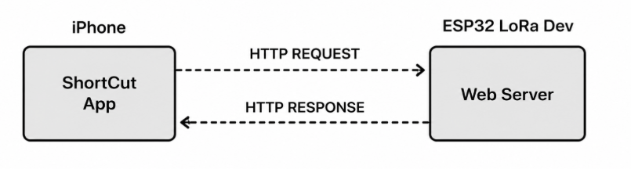
• BLE used for nearby device scanning
• RSSI monitoring for nearby devices
• Smartwatch detection support
• Wi-Fi used for web server communication
• Apple Shortcut battery updates
• Remote dashboard interaction
BLE and Wi-Fi communication

Slide 8
Method and strategy-Display
Uses Elecrow 7-inch ESP32-S3 display module
Display interface built using LVGL and LovyanGFX
Replaced original small OLED display system
Supports multiple dashboard UI pages
Displays weather information in real time
Displays music playback interface
Shows battery information for connected devices
Displays nearby BLE devices and RSSI values
Supports portrait and landscape screen layouts
Integrated with SmartHub dashboard architecture for real-time updates

Slide 9
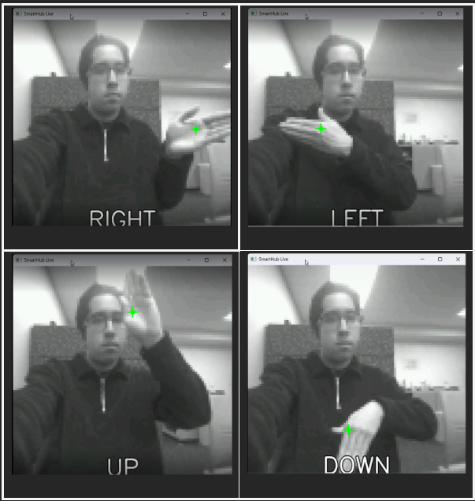
Method and strateg- Camera and Hand gesture

Slide 10
Method and strategy-Camera and Hand gesture
Uses Seeed Studio XIAO ESP32S3 Sense camera module
Supports real-time hand gesture recognition
Custom dataset collected and trained using Edge Impulse
Camera captures 96×96 grayscale images for reduced memory usage
Recognizes gestures such as LEFT, RIGHT, UP, and DOWN
Gesture system used for automatic screen rotation control
Current hand gesture model accuracy is approximately 92.9%
Uses centroid-based movement tracking for gesture detection

Slide 11
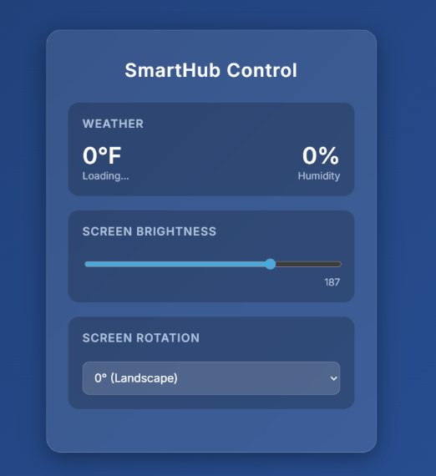
Web Server and Remote Controller

Slide 12
Power measurements and lifetime calculation
Power analysis performed for SmartHub receiver, LoRa node, and servo subsystem
SmartHub receiver includes display, Wi-Fi, and web server
SmartHub receiver consumes approximately 470 mA continuously
High current draw mainly caused by large display and Wi-Fi activity
SmartHub receiver currently powered using dedicated 5V wall supply
Servo motor current peaks reached up to 8.2 A during rotation
Average servo motor current during movement is approximately 2.44 A
LoRa transmitter consumes approximately 129 mA during transmission
LoRa node deep sleep current is approximately 0.5 mA for low-power operation
Estimated battery lifetime for LoRa transmitter is approximately 52 days using a 2000 mAh battery
Notes:
power measurements and lifetime calculation

Slide 13
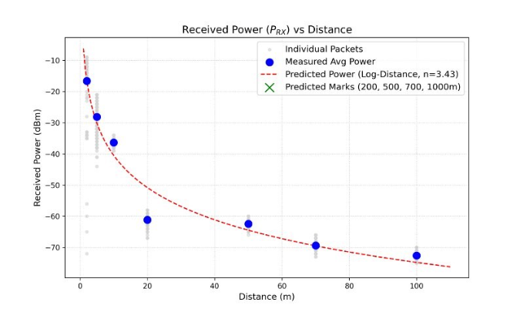
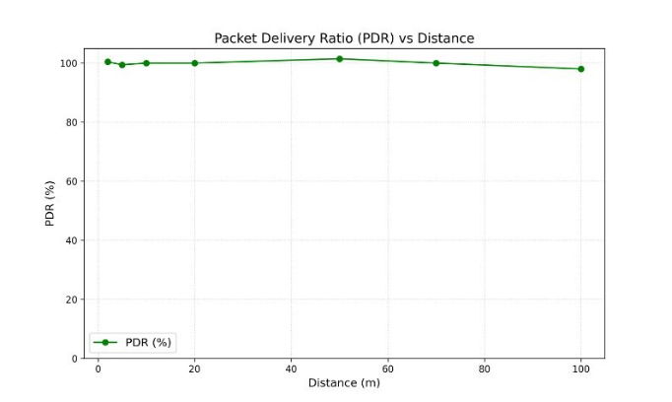
Evaluation and Verification-LoRa Communication
Received power plot
Packet delivery ratio
Notes:
evaluation and verification

Slide 14
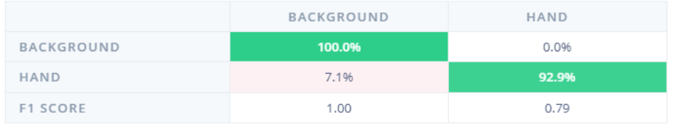
Evaluation and Verification-hand gesture camera

Slide 15
Summary and conclusions
The SmartHub project uses multiple ESP32 devices with LoRa, BLE, and Wi-Fi communication technologies to create a student-focused smart dashboard.
The system displays weather, music playback, battery information, BLE devices, temperature, humidity, and other real-time data.
LoRa communication provides reliable long-distance wireless transmission between ESP32 nodes for environmental sensor monitoring.
BLE is used for nearby device scanning and smartwatch communication, while Wi-Fi enables web server access and remote interaction.
The project includes a 7-inch ESP32 display, camera-based gesture recognition, automatic screen rotation, and web-based control features.
Power analysis and subsystem integration were completed to improve system reliability and optimize battery usage.
Notes:
summary and conclusions

Slide 16
Lesson learned
Large IoT systems require modular subsystem design for easier integration and debugging.
LoRa, BLE, and Wi-Fi each provide different advantages depending on communication range and power requirements.
Isolated power domains are important for preventing ESP32 brownout resets and improving system reliability.
Deep sleep operation greatly improves battery lifetime for remote sensor nodes.
Embedded machine learning requires balancing model accuracy, memory usage, and processing speed.
Notes:
summary and conclusions

Slide 17
Recommendation
Espressif Systems, “ESP32 Technical Reference Manual,” Espressif Systems, 2024.
Semtech Corporation, “SX1261/2 Data Sheet,” Semtech Corporation, 2023.
LVGL, “LVGL Graphics Library Documentation.” [Online]. Available: https://lvgl.io LovyanGFX, “LovyanGFX Graphics Library for ESP32.” [Online]. Available: https://github.com/lovyan03/LovyanGFX
OpenWeatherMap, “Current Weather Data API.” [Online]. Available: https://openweathermap.org/api
Arduino Documentation, “WiFi Web Server Example.” [Online]. Available: https://www.arduino.cc
Elecrow, “ESP32-S3 7-inch Display Documentation.” [Online]. Available: https://www.elecrow.com
Heltec Automation, “WiFi LoRa 32 Documentation.” [Online]. Available: https://heltec.org
Lesson learned:
Notes:
recommendations
lessons learned

